Slide 1
Selenium Grid

Slide 2
What is Grid?
It is used to run multiple tests across different browsers and operating systems in parallel.
It has 2 versions – Grid 1 and Grid 2.
Grid 1 is being deprecated by the Selenium.
It uses a hub-node (Master Slave) concept where tests are only run on a single machine (hub), but execution will be done by different machines called nodes in parallel.

Slide 3
When to use?
Need to run tests against multiple browsers and operating systems at the same time.
Need to save execution time of test suites.

Slide 4
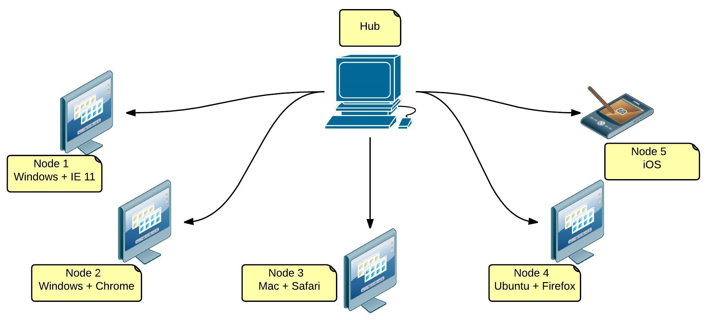
Grid Infrastructure

Slide 5
The Hub
Machine where you load all the tests.
There should only be one hub in a grid.
Hub is where the tests will run, but you will see the browser execution on the nodes.

Slide 6
The Nodes
Machines that will execute the tests that you loaded on the hub.
There can be one or more nodes in a grid with different browsers and OS.

